Slide 1
MA2012
C++ Programming for Arduino
Outline:
Introduction to C++ & Arduino IDE
Variable and Datatype
Control Statements
Operations
Functions
Class
Others

Slide 2
Introduction to C++ & Arduino
C++
A general-purpose programming language, cross-platform, compatible with C
Object-oriented with well encapsulated class
Close to hardware, and maintains some degree of access to low-level programming functions (memory management, etc.)

Slide 3
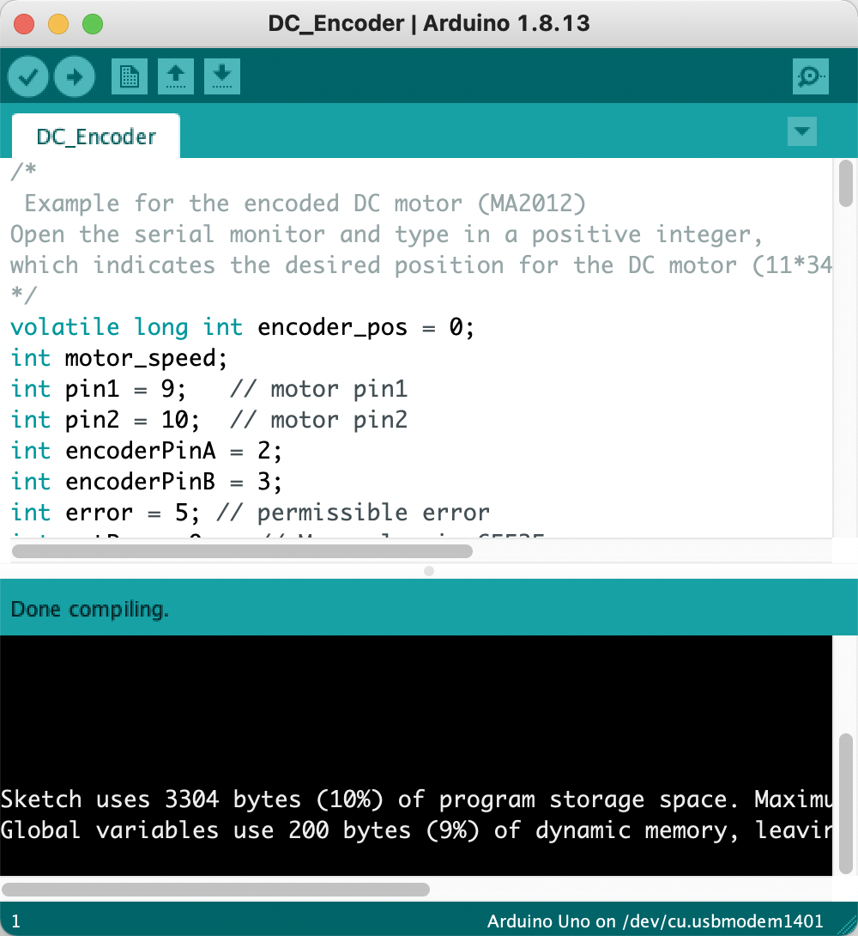
Introduction to C++ & Arduino IDE
Arduino IDE
A text editor
Supports C++ programming language
Uploads the program to the controller
Allows communication between the controller and the PC
Serial Monitor:
a debugging and communication tool

Slide 4
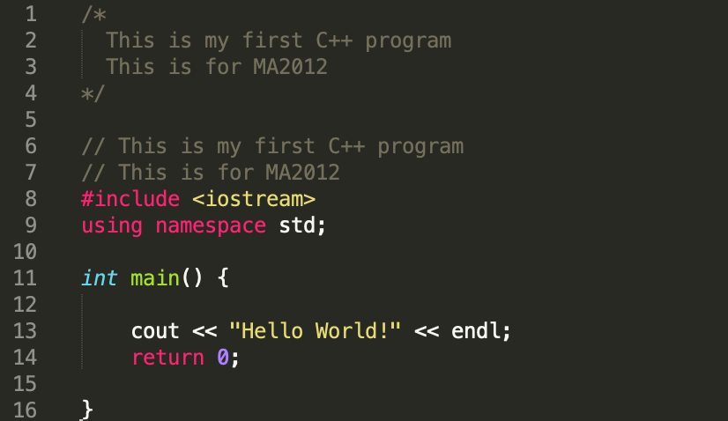
Introduction to C++ & Arduino IDE
Comment multiple lines. In Python: ’’’……’’’
Hello-world C++ program
Comment single line.
In Python: #......
Include some standard libraries
Namespace avoids name collisions
main function. It can also have parameters like:
int main (int argc, char *argv[]){}. main() function is the entry point to the program
Display the output to the monitor
Return value
Insert newline

Slide 5
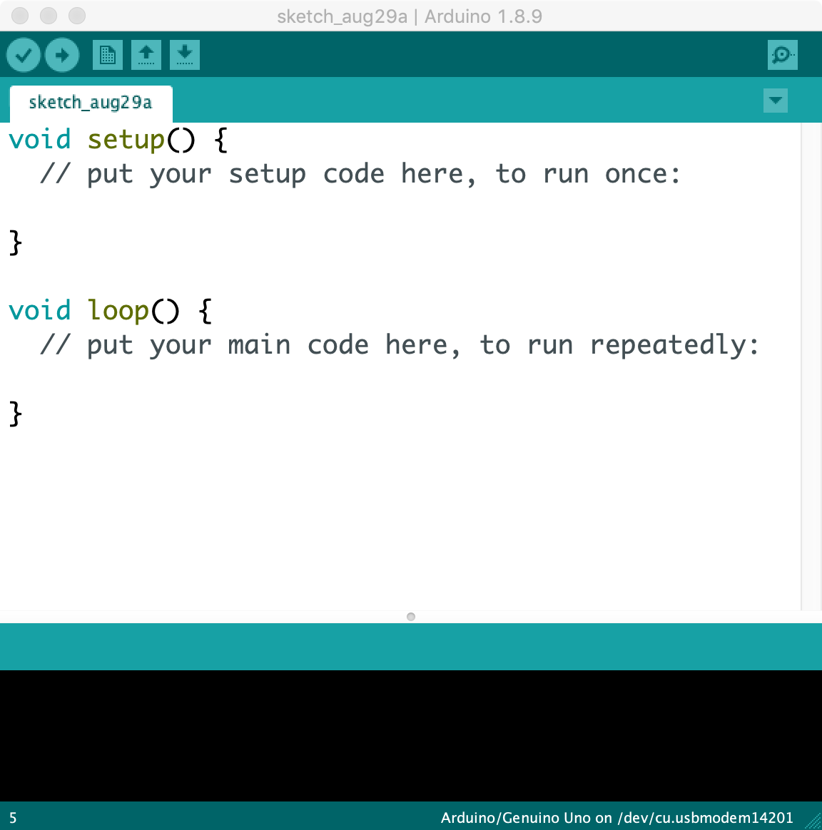
Introduction to C++ & Arduino IDE
setup(): The function is to initialize variables, pin modes, start using libraries, etc. The setup() function will only run once, after each powerup or reset of the Arduino board.
Program structure in Arduino
loop(): This function does precisely what its name suggests, and loops consecutively, allowing your program to change and respond.
Why there is no main() function?
https://www.arduino.cc/en/Tutorial/BuiltInExamples/BareMinimum/

Slide 6
Introduction to C++ & Arduino IDE
Comparison between C++ & Python
C++ | Python
No garbage collection | Has inbuilt garbage collection
Compiler (will be compiled once to generate the executable file) | Interpreter (statement by statement)
Suitable for Application and system programming, games, computer graphics, mechatronics, and etc. | Wildly used in Web development, data analysis, AI, etc.
Efficient, fast and stable | Extensive support library but lower running speed

Slide 7
Variables and Data types in C++
Common used data types in C++
One byte = collection of 8 bits
Declaration |  |  | Bytes (Uno)
Signed | Unsigned
[signed] char | unsigned char |  | 1
short | unsigned short |  | 2
int | unsigned |  | 2
long | unsigned long |  | 4
char * |  |  | 2
float |  |  | 4
double |  |  | 4
int : range from -32768(-2^15 ) ~ 32767 (2^15 -1)
unsigned int: range from ? to ?
int buttonPin = 4;
const int Pin1 = 3; // keyword const indicates that Pin1 // is a read-only value, cannot be changed
bool pinPressed = false;
float a = 3.14;
double b = 6.22;
Some other data types: bool, void, array and etc.
Notes:
Why these is no unsigned float? Precision vs Range

Slide 8

Variables and Data types in C++
Variable are containers for storing data values, they must be declared before use (different from the usage in Python)
int pinNumber = 10; //single variable
int pinNum1, pinNum2, pinNum3; // multiple variables
C++ is a strongly typed language (Python is weakly typed)
int n = 10; // int type variable
n = 100;
n = “https://www.ntu.edu.sg/Pages/home.aspx” //$×$ string cannot be assigned to an int //variable
url = “https://www.ntu.edu.sg/Pages/home.aspx” //$×$ unspecified type
C++ is case sensitive
Data type
Variable name
initialization

Slide 9
Variables and Data types in C++
Comparison between C++ & Python
C++ | Python
int a = 0; // declared with type | a = 0; // datatype is set when a // value is assigned to a variable
int n = 10; n = ‘a’; //Error, not allowed | n = 10 # integer n = “Hello” # string
int a = 0, b= 0, c=0; | a = b = c = 0
Notes:
Why these is no unsigned float? Precision vs Range

Slide 10
Variables and Data types in C++
Array
A collection of homogeneous data (data of the same type)
int ages [5]; // declaration of an array with 5 elements of type int
int ages [5] = {16, 17, 18, 15, 17}; // explicitly initialize the array in declaration
int ages[] = {16, 17, 18, 15, 17}; // declaration without specified limits
0 | 1 | 2 | 3 | 4
ages
16 | 17 | 18 | 15 | 17
Array index starts from zero
bool female[5] = {0, true, false, -200}
female[5] = true; // store value into last, 5th element
Array is not assignable
bool male [5];
male = female; //$× array assignment is invalid$

Slide 11
Variables and Data types in C++
Array(Two dimensional)
Declaration & Initialization
int seatID [2][3]; // declaration of 2D array with 5 rows and 8 columns
int seatID[2][3] = {{1, 2, 4}, {3, 5, 6}}; 1️⃣
int seatID[2][3] = {1, 2, 3, 4, 5, 6}; 2️⃣
int seatID[2][3] = {{1, 2}, 4}; 3️⃣
int seatID[][3] = {1, 2, 3, 4, 5, 6}; // how about seatID[][3] = {1, 2, 3, 4, 5, 6, 7}
Second subscript
first subscript
1 | 2 | 3
4 | 5 | 6
7 | 0 | 0
1 | 2 | 4
3 | 5 | 6
1 | 2 | 3
4 | 5 | 6
1 | 2 | 0
4 | 0 | 0
1️⃣
2️⃣
3️⃣

Slide 12
Variables and Data types in C++
Data type - pointer
A pointer is a variable that stores the memory address as its value
variable
name
content
address
0x1001
0x1002
0x1003
0x1004
…
…
int x, y;
int *ptr1; // pointer variable, which points to an integer data
// “*”, Pointer operator, declare a pointer
int **ptr2; // pointer points to a pointer
ptr1 = &x; // get the address of x, and stores it in ptr1.
//“&” Pointer operator, get the address of the variable
*ptr1 = 300; // assign 300 to the address stored in ptr1.
//“*”, dereference a pointer
ptr2 = &ptr1; // put the address of ptr1 in the place with the // address of ptr2
x
y
ptr1
ptr2
300
0x1001
0x1003

Slide 13
Variables and Data types in C++
Data type - void
The void keyword is used only in function declarations. It indicates that the function is expected to return no information to the function from which it was called.

Slide 14
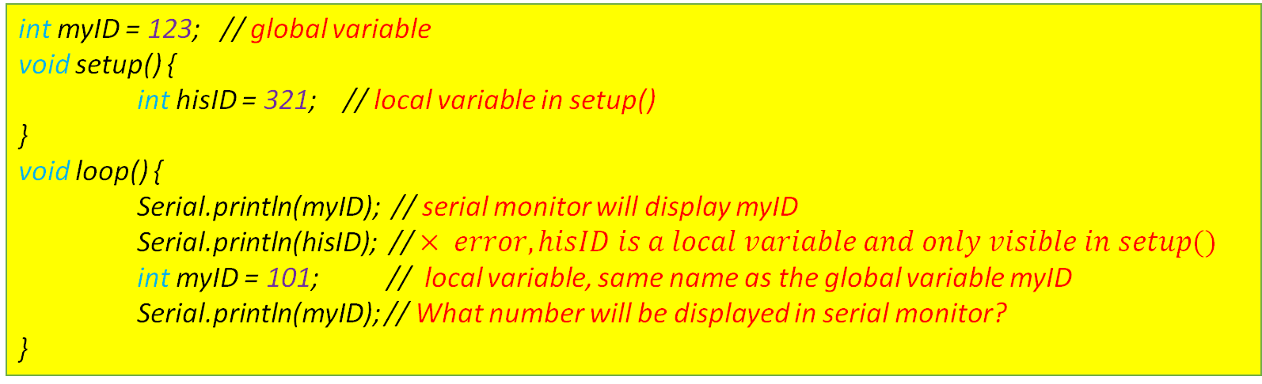
Variables and Data types in C++
Scope of variables in C++
When a variable is declared, it can only be ”seen” and used in certain part of the program
Typically, there are two types of variable scopes
Local variables
Global variables
int myID = 123; // global variable
void setup() {
int hisID = 321; // local variable in setup()
}
void loop() {
Serial.println(myID); // serial monitor will display myID
Serial.println(hisID); // $× error, hisID is a local variable and only visible in setup()$
int myID = 101; // local variable, same name as the global variable myID
Serial.println(myID); // What number will be displayed in serial monitor?
}

Slide 15
Control Statements
Selection Statements
if (a > b) {
// do thing A...
} else {
// do thing B...
}
if – else statement
Valid conditions:
Comparison
Integer values (0 = false, others = true)
switch (a) {
case 1:
// do something when a = 1 ...
break;
case 2:
// do something when a = 2 ...
break;
default: // optional
}
switch-case statement
Variables(var) in switch() must be integer (or can be converted to integer)
break: stop and exit switch()
default: catch all unmatched cases

Slide 16
Control Statements
Repetition Statements
In python
while (a > b) {
// do something…
}
while statement
Valid conditions:
Comparison
Integer values (0 = false, others = true)
Checking condition can be before or after executing the body
while a > b:
# do something…
do {
// do something…
} while (a > b)
for loop
Statement A: initialization (eg. int i = 0). Will be executed only once before the execution of the code block
Statement B: condition (eg. i < 100). Define the condition of the code block
Statement C: update (eg. i++). Will be executed every time after the code block has been executed
for (A; B; C) {
// do something…
}

Slide 17
Control Statements
if-else in C++ and Python
if (i>2){
cout<<i<<endl;
} else {
cout<<-i<<endl;
}
if (i>2):
print(x)
else:
print(-i)
for loop in C++ and Python
for (int i = 1; i<7; i++){
cout<<i<<endl;
}
for x in range(1, 7):
print(x)

Slide 18
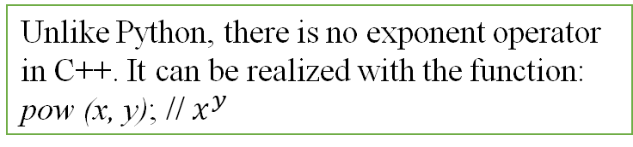
Operations
Arithmetic operators
Unlike Python, there is no exponent operator in C++. It can be realized with the function:
pow (x, y); // $x^{y}$
Operator | Description | Example | Result (a)
= | assignment | int a = 2 | 2
+ | addition | int a = 3+2 | 5
- | subtraction | int a = 3-2 | 1
* | multiplication | int a = 3*2 | 6
/ | division | double a = 3/2 | 1.5*
% | modulo | int a = 3%2 | 1
* int a = 2; int b = 3; double c; c = b/a; What is the value of c?

Slide 19
Operations
Increment and decrement
Compound assignment
 | Equivalent to…
++x or x++ | x = x + 1
--x or x-- | x = x - 1
Expression | Equivalent to…
y += x | y = y + x
y -= x | y = y - x
y /= x | y = y / x
y *= x | y = y * x
Any difference between ++x and x++?
int x = 5;
int y, z;
y = x++; // y = 5, x = 6
z = ++x; // z = 7, x = 7
Notes:
In expressions, ++x do the self increment first, then return the value of x; x++ firstly return the value of x, then do the self increment.

Slide 20
Operations
Relational and comparison operators
Operator | Description
== | Equal to
!= | Not equal to
< | less than
> | larger than
>= | No smaller than
<= | No larger than
Logical operators
Operator | Example | result
! (not) | !(5 == 6) | true
&& (and) | (5 == 5) && (4 <5) | false
|| (or) | (5 == 5) || (4 <5) | true
In Python, the operators are not, and, or.

Slide 21
Operations
Explicit type casting operator
It allows to convert a value of a given type to another type
Recall
int a = 2; int b = 3; double c; c = b/a; What is the value of c?
How to get the accurate value?
int a = 2;
int b = 3;
double c;
c = (double) b/a; // c = 1.5
float y = 3.14;
int x = (int) y; // x = 3
Casting in Python
y = 3.14
x = int(y); # x = 3
Notes:
is to precede the expression to be converted by the new type enclosed between parentheses (()):

Slide 22
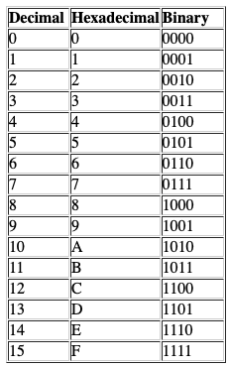
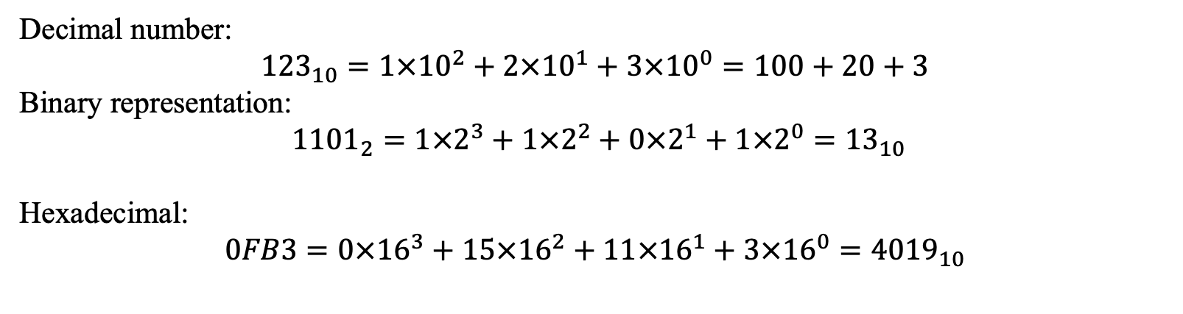


Operations
Representation of Numbers
Decimal number:
$${123}_{10}=1×{10}^{2}+2×{10}^{1}+3×{10}^{0}=100+20+3$$
Binary representation:
$1{101}_{2}=1×2^{3}+1×2^{2}+0×2^{1}+1×2^{0}={13}_{10}$
Hexadecimal:
$$0FB3=0×{16}^{3}+15×{16}^{2}+11×{16}^{1}+3×{16}^{0}={4019}_{10}$$
2
19
2
9
1
2
4
1
$${19}_{10}→{\left(?\right)}_{2}$$
2
2
0
$${19}_{10}={10011}_{2}$$
2
1
0
0
1

Slide 23
Operations
Bit-level operation
Boolean operations
~
0 | 1
1 | 0
& | 0 | 1
0 | 0 | 0
1 | 0 | 1
| | 0 | 1
0 | 0 | 1
1 | 1 | 1
^ | 0 | 1
0 | 0 | 1
1 | 1 | 0
NOT
AND
OR
EXCLUSIVE OR
~
 | 1100
 | 0011
& | 0110
 | 1100
 | 0100
| | 0110
 | 1100
 | 1110
^ | 0110
 | 1100
 | 1010

Slide 24
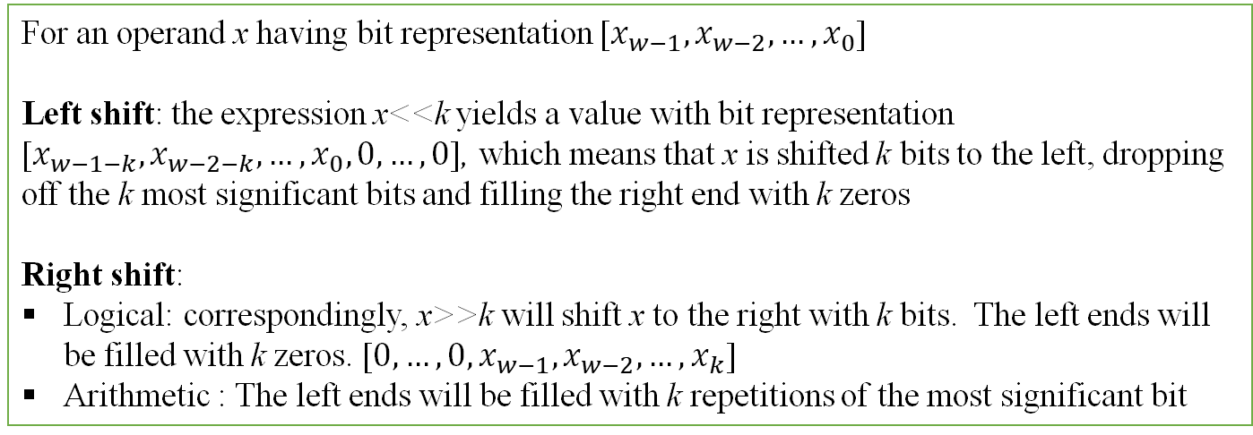
Operations
Bit-level operation
Shift Operations
<< or >>, for shifting bit patterns to the left or to the right
For an operand x having bit representation [$x_{w−1},x_{w−2},…, x_{0}$]
Left shift: the expression x<<k yields a value with bit representation [$x_{w−1−k},x_{w−2−k},…, x_{0}, 0,…, 0$], which means that x is shifted k bits to the left, dropping off the k most significant bits and filling the right end with k zeros
Right shift:
Logical: correspondingly, x>>k will shift x to the right with k bits. The left ends will be filled with k zeros. [$0,…, 0, x_{w−1},x_{w−2},…, x_{k}$]
Arithmetic : The left ends will be filled with k repetitions of the most significant bit
Value of X | [01100011] | [10010101]
x<<4 | [00110000] | [01010000]
x>>4 (logical) | [00000110] | [00001001]
x>>4 (arithmetic) | [00000110] | [11111001]

Slide 25
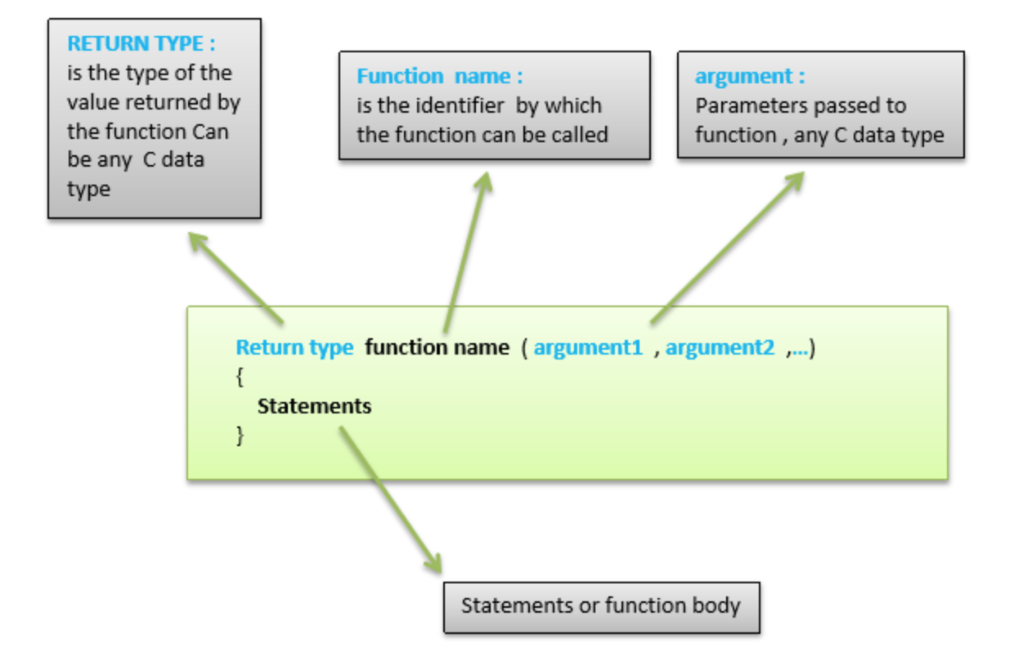
Function
Self contained
only relies on input parameter
output is well defined
Portable
Ease of maintenance
A function is a subprogram that returns a single value. You must declare and define a function before invoking it. You can either declare and define it at the same time, or you can declare it first and then define it later in the same block. Codes after the return statement will not be executed.

Slide 26
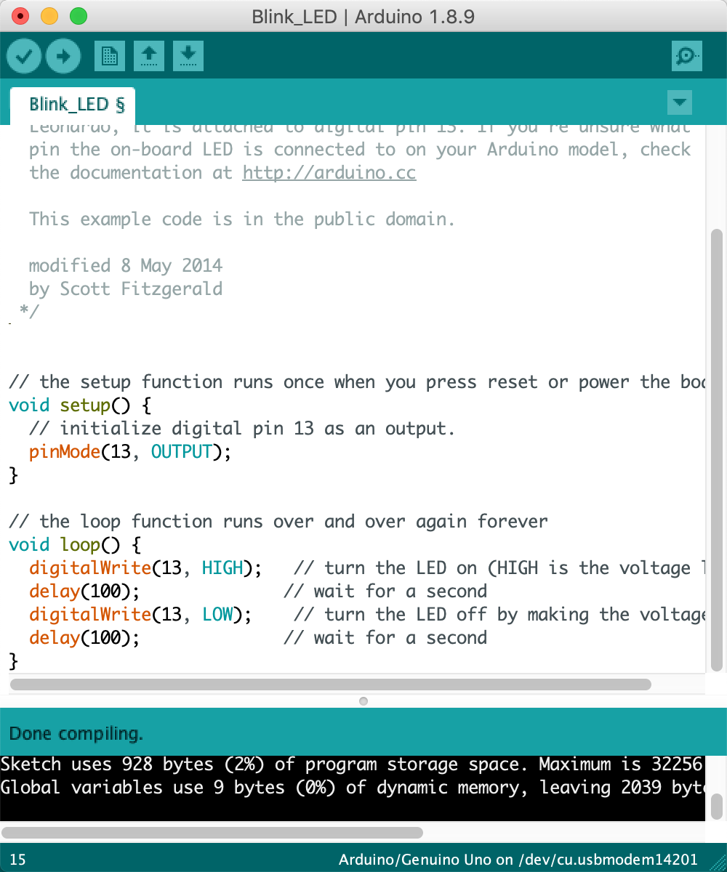
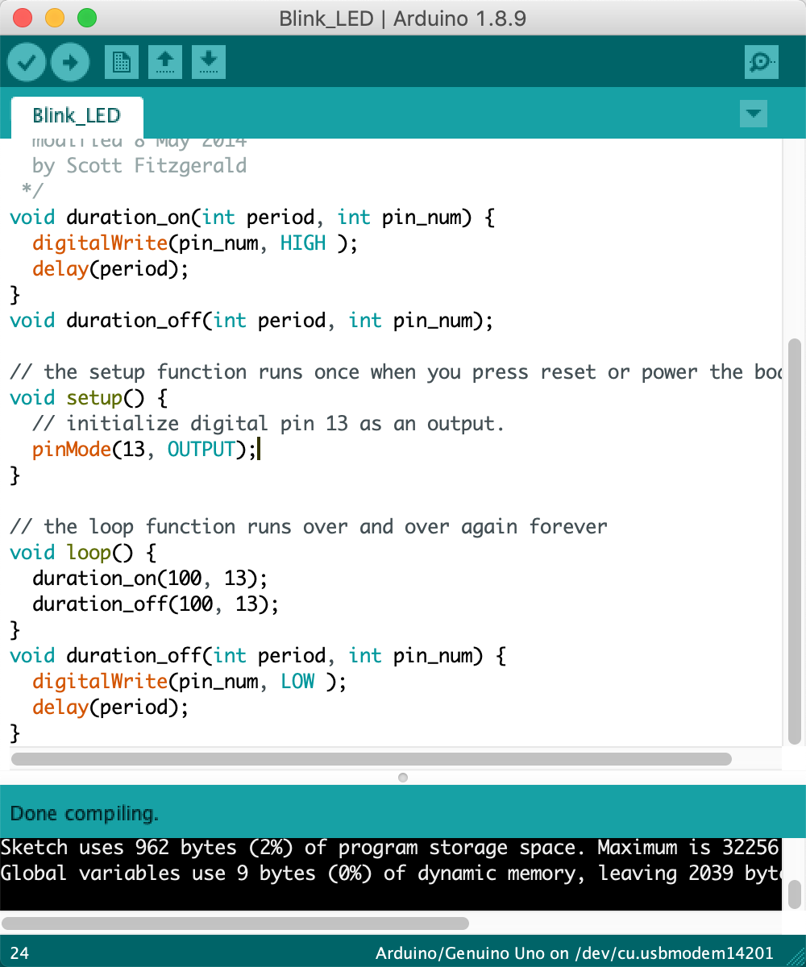
Function
Definition:
duration_on
Declaration:
duration_off
Call the functions, pass by value
Definition:
duration_off

Slide 27
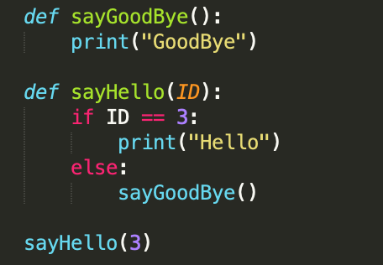
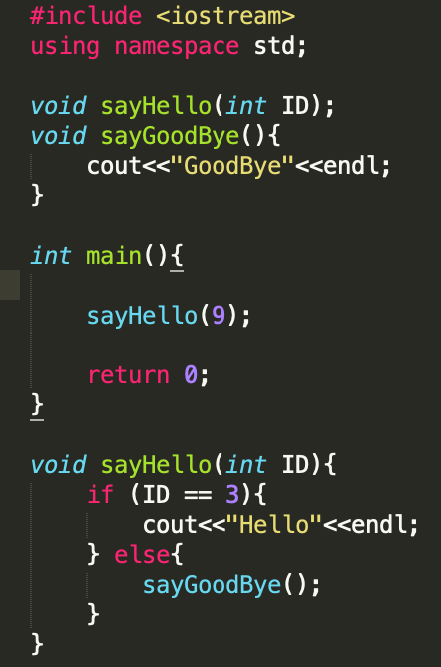
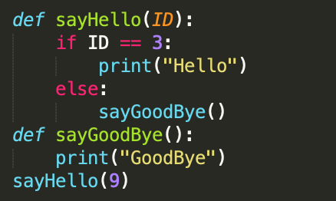
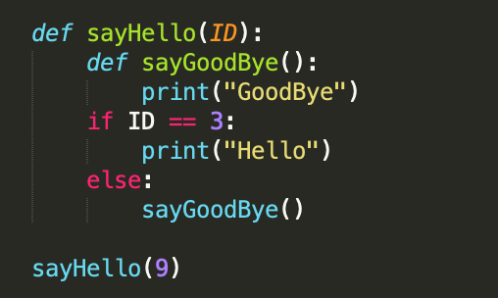
Function
Function must be defined before it is called
functions in C++ and Python
sayHello is declared before it is called
Unless it is called by another function
sayGoodBye is defined before it is called
sayHello is defined after it is called
Nested function. Not supported in C++
C++
Python

Slide 28
Class in C++
C++ is an object-oriented programming language.
Everything in C++ is associated with classes and objects, along with its attributes and methods. For example: in real life, a car is an object. The car has attributes, such as weight and color, and methods, such as drive and brake.
Attributes and methods are basically variables and functions that belongs to the class. These are often referred to as "class members".
A class is a user-defined data type that we can use in our program, and it works as an object constructor, or a "blueprint" for creating objects.

Slide 29
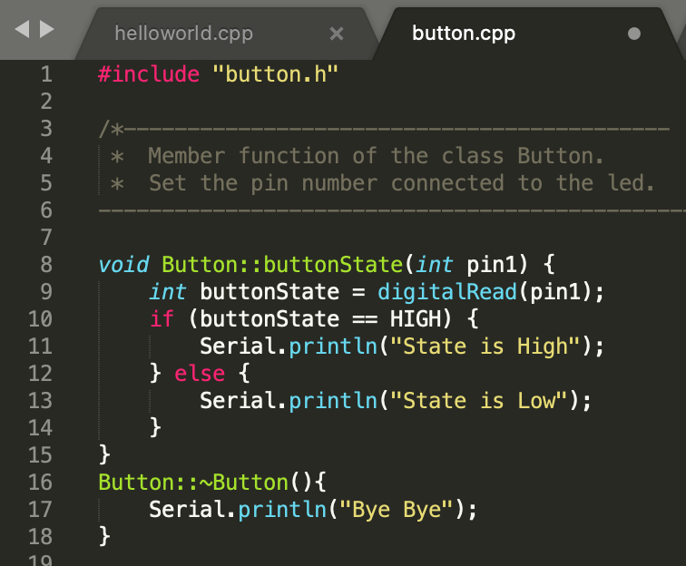
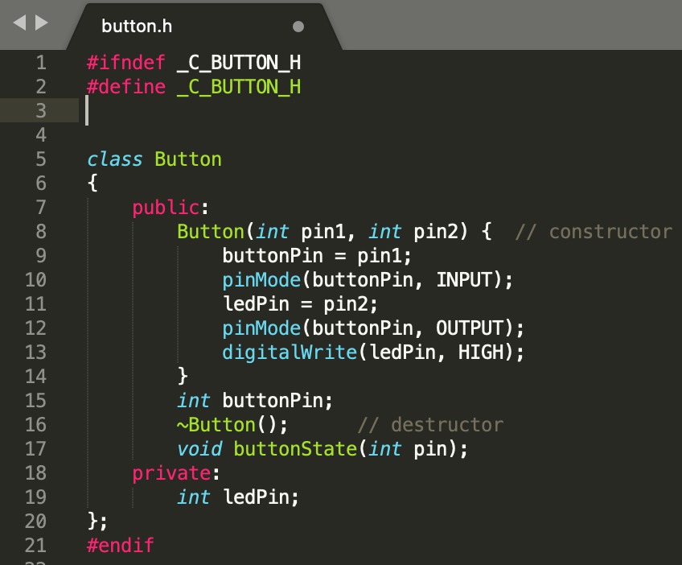
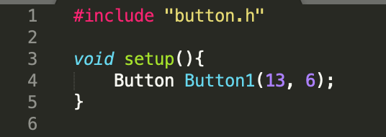
Class
A Button class object (Button1) is created.
The button and the LED are connected to pin 13 and 6, respectively.
Open the serial monitor, if the button is pressed, there will be a sentence “State is High”. Otherwise, there will be ”State is Low”.
Then the destructor function will let the serial monitor display “Bye Bye”

Slide 30
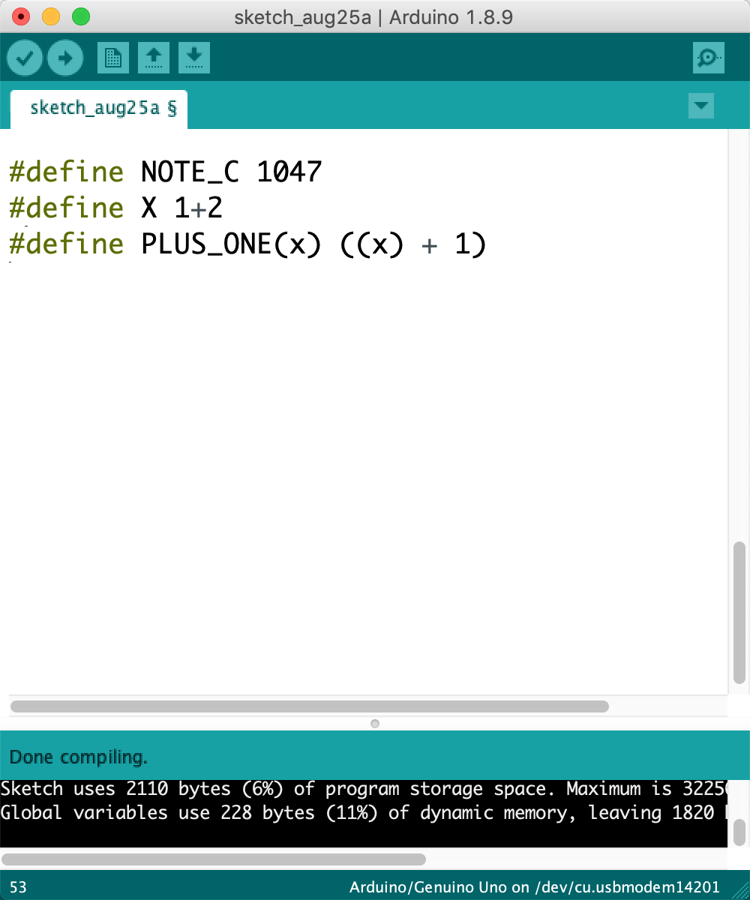
Macros
A macro is a fragment of code which has been given a name. Whenever the name is used, it is replaced by the contents of the macro. There are two kinds of macros. They differ mostly in what they look like when they are used. Object-like macros resemble data objects when used, function-like macros resemble function calls.

Slide 31
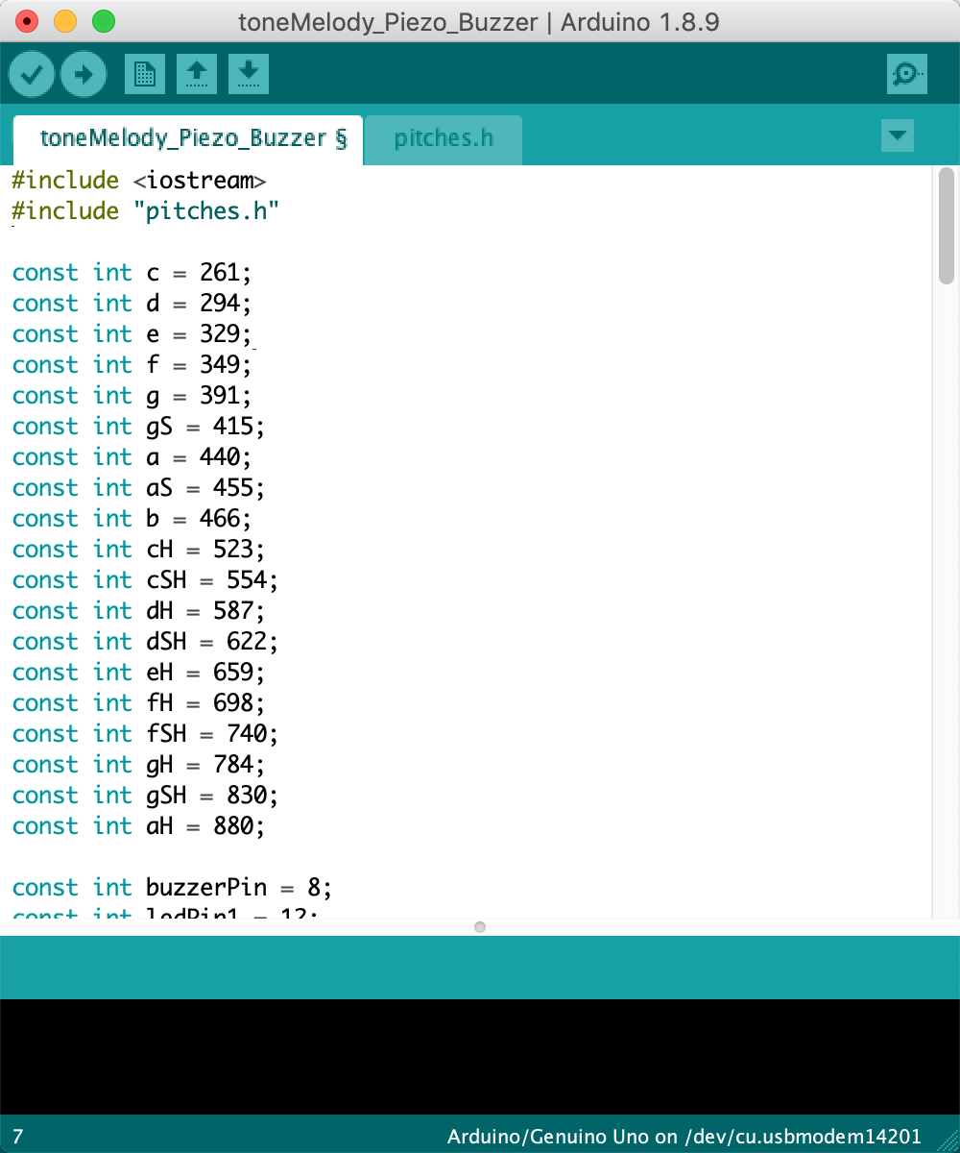
Header file
# include " q-char-sequence " new-line:
search the files under the same directory of the source file
# include < h-char-sequence > new-line:
search the files under the specified directory or the default directory where standard library files locate
It is recommended to put your own header file and other .cpp files under the same directory of your main file. Otherwise, you need to specify the route when you compile the code

Slide 32
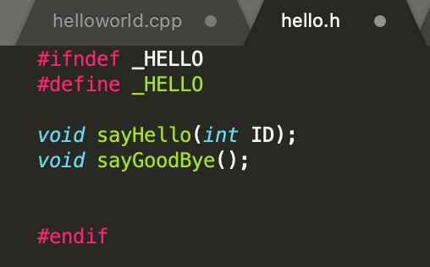
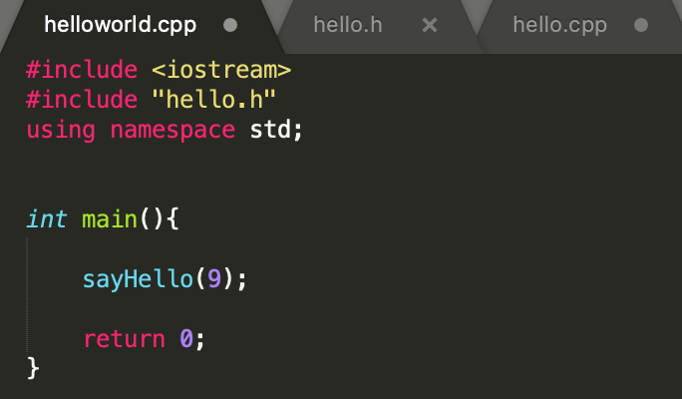
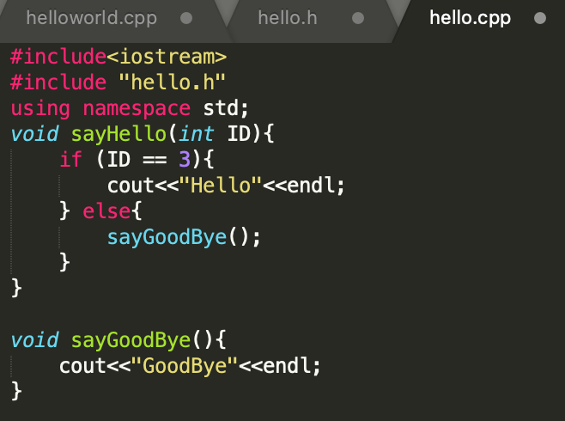
Header file
Functions are declared in the header file
Functions are implemented in another .cpp file

Slide 33
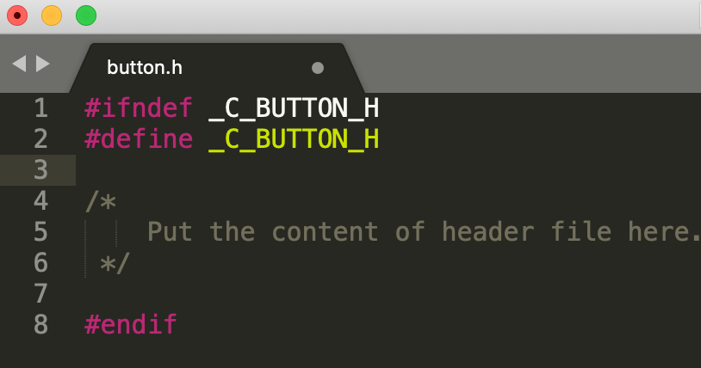
Header file
Header Guards
Header guards help to avoid the duplicate definition problem
https://www.learncpp.com/cpp-tutorial/header-guards/

Slide 34
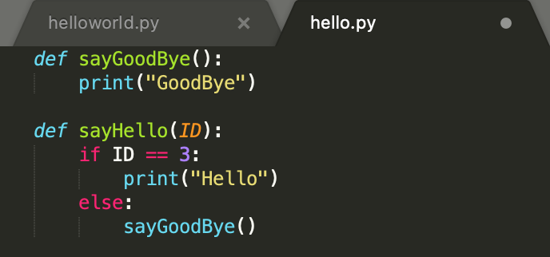
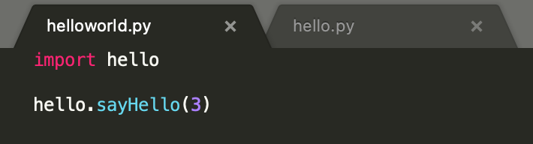
Header file
Practice in Python
helloworld.py and hello.py are in the same folder

